Slide 1
Traffic Violation Detection System

Slide 2
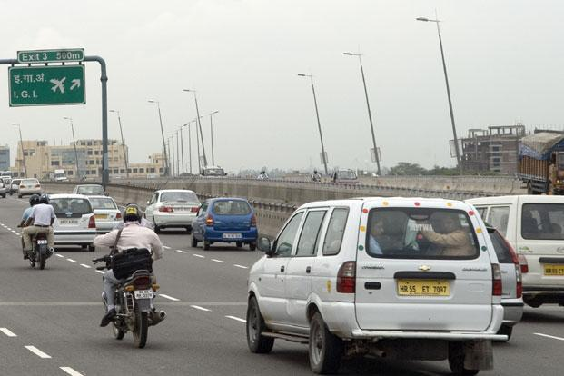
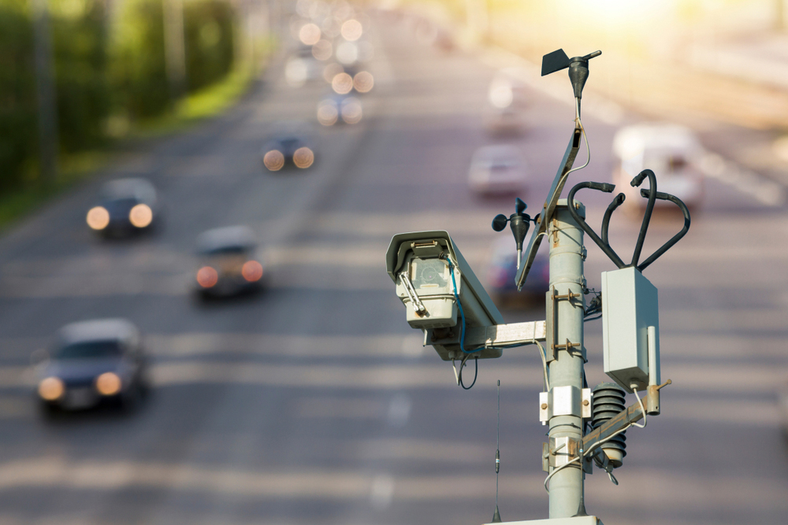
Motivation
The rise in accidents due to reckless driving led us to adopt technology, specifically computer vision and machine learning, for a Real-time Traffic Violation Detection System. Our aim is to quickly spot traffic violations using effective models like 3 layer CNN. This project stemmed from our mutual worry about road safety and the power of technology to make a difference. We developed this solution to match technological advancements with real safety issues in the world.

Slide 3
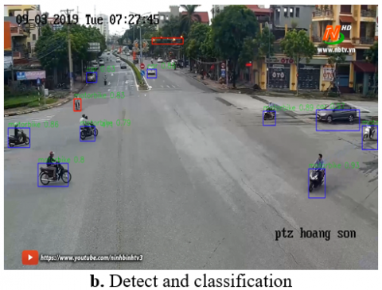
Literature Review
The paper on "Automatic Traffic Red-Light Violation Detection Using AI":
Objective: The paper aims to develop a machine learning-based system for detecting traffic signal violations, particularly red-light violations, to address the growing number of road accidents caused by rule infractions.
Methodology: YOLO v5s recognize vehicles and optimize the system for accuracy using region-of-interest and vehicle location analysis.
Results: The system achieves high accuracy rates, with 82% for vehicle identification, 90% for detecting traffic signal status changes, and up to 86% for violation detection. Real-time results include detecting red-light violations, vehicle classification, and license plate extraction.

Slide 4
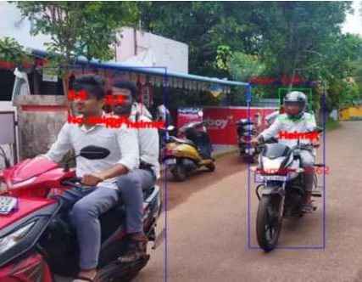
Literature Review
2. "Traffic Surveillance System and Criminal Detection Using Image Processing and Deep Learning":
Objective: The paper addresses the challenges of traffic violations and criminal activities on roads, aiming to enhance security and safety. It proposes a system that utilizes image processing and deep learning to intelligently identify traffic offenders by recognizing license plates, detect accidents, and identify criminals.
Methodology: The system employs RetinaNet, a one-stage object detection technique and OCR for plate reading.
Circuit and Experimental Results: The paper provides details of the system's circuit diagram, highlighting the integration of Arduino, GSM, and GPS modules. Experimental results demonstrate the effectiveness of the proposed system, including helmet detection, accident alerts, and criminal identification. RetinaNet is found to perform well, and the system shows promise for real-time applications.

Slide 5
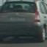
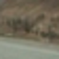
Dataset
Dataset used before mid-sem evaluation
Vehicles: https://s3.amazonaws.com/udacity-sdc/Vehicle_Tracking/vehicles.zip
Non-vehicles: https://s3.amazonaws.com/udacity-sdc/Vehicle_Tracking/non-vehicles.zip
The dataset consists of frame images that were taken from a section of CCTV video. These pictures show both automobiles and non-automobile objects. The photographs are displayed without any precise categorization and in the manner in which the CCTV system originally recorded them. The dataset's content consists of numerous scenes with both automobiles and non-vehicle objects in view.

Slide 6
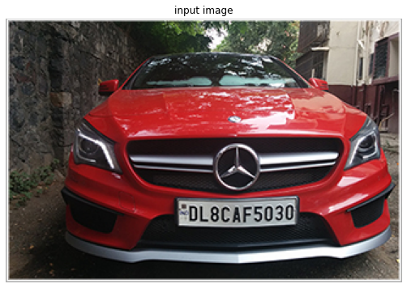
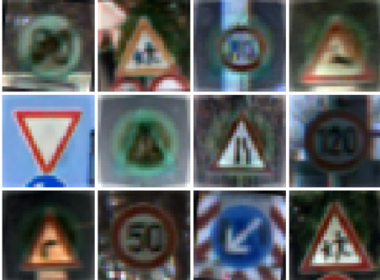
Dataset
Dataset used after mid-sem evaluation
License plate: https://www.kaggle.com/datasets/sarthakvajpayee/ai-indian-license-plate-recognition-data/download?datasetVersionNumber=1
The dataset consists of images of numericals, alphabets (to be used for training models for identifying license plate number i.e. converting image data to a number which is predicted to be license number of that vehicle (cars in our case). Then we have sql data of registered license numbers in India.
Traffic signs: https://www.kaggle.com/datasets/valentynsichkar/traffic-signs-preprocessed
Pre - processed data for traffic signs.

Slide 7
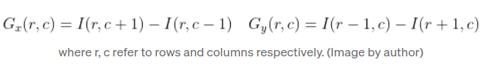
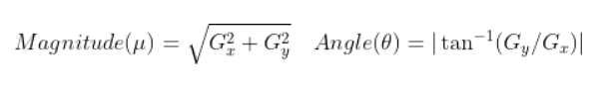
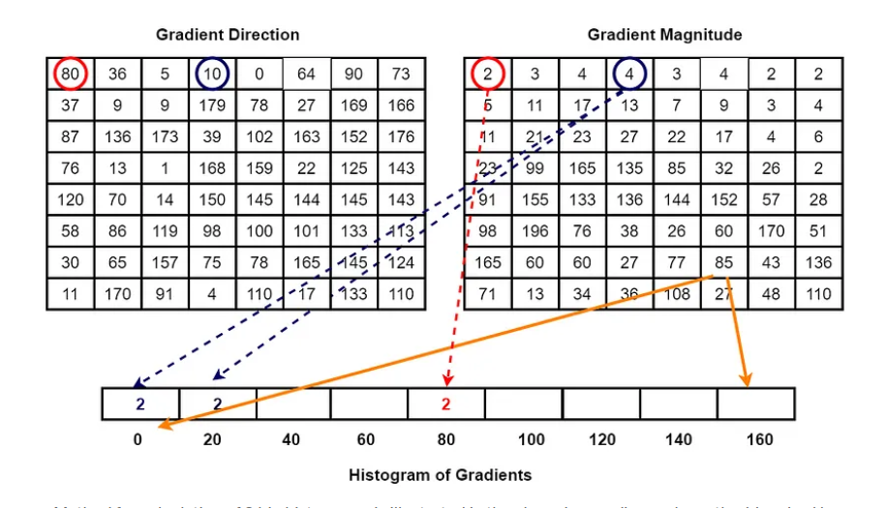
Preprocessing of vehicles dataset
Histogram of Oriented Gradients (HOG) is a key technique used for feature extraction from images. It works by capturing the distribution of gradients (edges) in different orientations within localized regions of an image.
Computing Gradient:
Reference

Slide 8
Flow of Processing
Color Conversion: converts the input image from the RGB color space to the specified color space
feature_image = cv2.cvtColor(image, cv2.COLOR_RGB2X)
Spatial Binning: resizes the image to a smaller size and flattens it into a one-dimensional array.
spatial_features=bin_spatial(feature_image,size=(32,32))
Color Histogram: computes the histogram of color channels separately and concatenates them into a feature vector.
hist_features=color_hist(feature_image,nbins=32)
Histogram of Oriented Gradients (HOG): features are extracted from a specific channel of the image using specified parameters like orientation, pixels per cell, and cells per block
hog_features = get_hog_features(feature_image[:,:,hog_channel], orient, pix_per_cell, cell_per_block)
Feature Vector Extraction: extracts spatial, color histogram, and HOG features from a single image based on specified parameters
img_features = single_img_features(image, color_space, spatial_size, hist_bins, orient, pix_per_cell, cell_per_block, hog_channel)
Batch Feature Extraction: iterates through a list of images and extracts features for each image, creating a feature matrix
features = extract_features(imgs, color_space, spatial_size, hist_bins, orient, pix_per_cell, cell_per_block, hog_channel)

Slide 9
Methodology tested before mid-sem evaluation
We use the Linear Support Vector Machine (SVM) and Logistic Regression machine learning classifiers to identify vehicles.
SVM is trained using a dataset that includes features taken from car and non-car photos for vehicle detection. Once trained, it can quickly categorise fresh photos, identifying whether or not a vehicle is there. The LinearSVC class from scikit-learn is used in the code to enable the SVM to learn and predict the presence of vehicles in the supplied photos.
Regression uses a logistic function to describe the likelihood that an input belongs to the positive class (vehicle). The input is categorised as a positive example if this probability is higher than a predetermined threshold, which is commonly 0.5; otherwise, it is categorised as a negative example.

Slide 10
Methodology tested after mid-sem evaluation
We use the CNN model for training the dataset of vehicles, as they are theoretically more reliable for classification based prediction.
Model Architecture:
The model starts with a dense layer of 512 neurons using ReLU activation.
A dropout layer is added to prevent overfitting by randomly dropping 50% of the neurons during training.
Another dense layer with 128 neurons and ReLU activation follows.
Finally, a dense layer with a single neuron and sigmoid activation is added for binary classification.
Compilation:
The model is compiled using the Adam optimizer and binary crossentropy loss, which is suitable for binary classification tasks.
Training:
The model is trained on the training data (X_train and y_train) for 10 epochs with a batch size of 32.
Evaluation:
The test set (X_test and y_test) is used to evaluate the model's performance.
Test loss and accuracy are printed.
Prediction and F1 Score:
The model predicts labels for the test set, and predictions are thresholded at 0.5.
F1 score is computed using the predicted and true labels.

Slide 11
Methodology tested after mid-sem evaluation
Model for training the dataset of License plate
pre-trained Haar Cascade classifier (plate_cascade) to detect license plates.
The segment_characters function takes a detected license plate image, processes it to enhance character visibility, and then uses contour detection to segment individual characters.
CNN (convolutional layer, max pooling, dropout, and dense layers) function of Keras library
The model is compiled using the sparse categorical cross-entropy loss function and the Adam optimizer with a specified learning rate.
Custom F1 score functions (f1score and custom_f1score) are defined for model evaluation.
The CNN model is trained using the fit_generator method with training and validation data generators. Training stops if the validation custom F1 score exceeds 0.99.
We use the CNN model for training the pre-processed dataset of Sign Recognition
Model Architecture:
Creates a Sequential model using Keras.
Adds a 2D convolutional layer with 32 filters, a kernel size of 3x3, 'same' padding, and ReLU activation.
Adds a 2D max pooling layer with a pool size of 2x2.
Flattens the output to a 1D array.
Adds a dense layer with 500 units and ReLU activation.
Adds the output layer with 43 units (assuming it's a classification task) and softmax activation.
Compiles the model using the Adam optimizer and categorical cross-entropy loss.

Slide 12
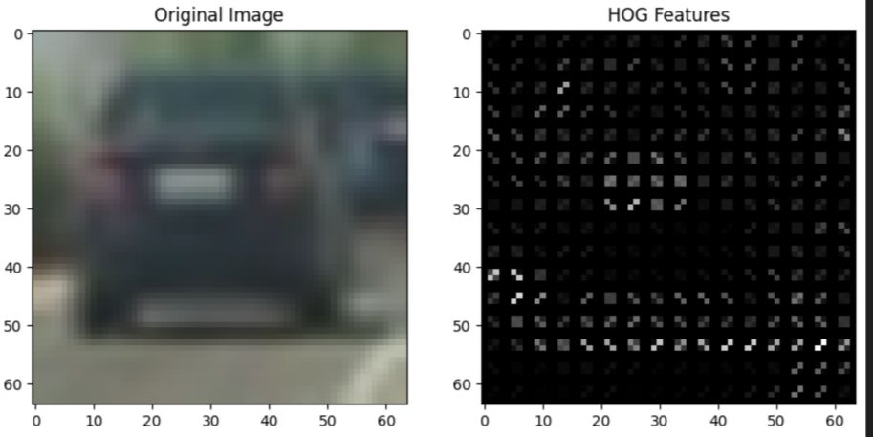
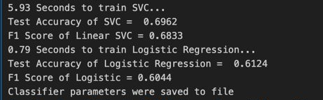
Results & Analysis for SVM and Regression
LR accuracy = 0.6044
SVC accuracy = 0.6962
SVC has better accuracy than LR
The HOG descriptor will capture information about the edges and gradients in different parts of the image, emphasizing features that are characteristic of the object (vehicle)

Slide 13
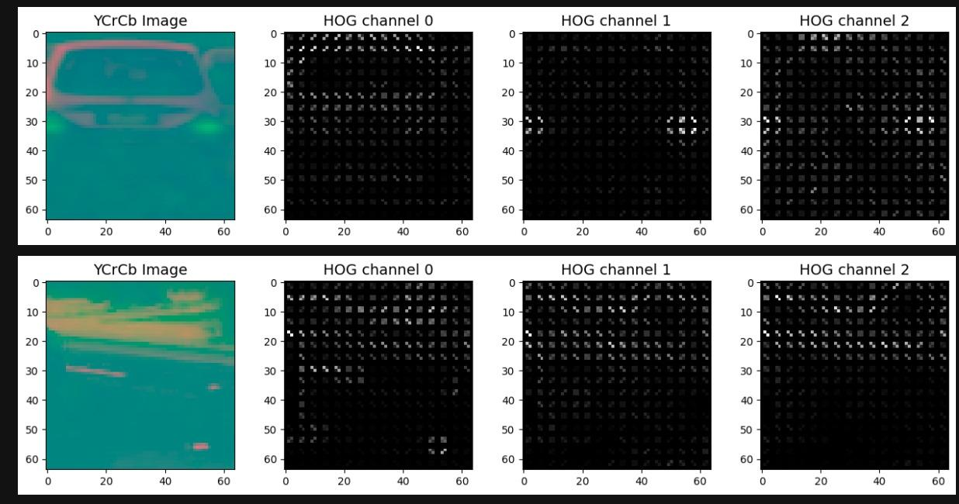
Results & Analysis for SVM and Regression
For color images, each color channel can be treated independently, and HOG features can be computed for each channel separately. This means that for an RGB image, you would compute HOG features for the Red, Green, and Blue channels separately.
Computing HOG features independently for each color channel in a color image provides additional information about the spatial distribution of gradients and edges in different color channels. This can be beneficial in various computer vision tasks.

Slide 14
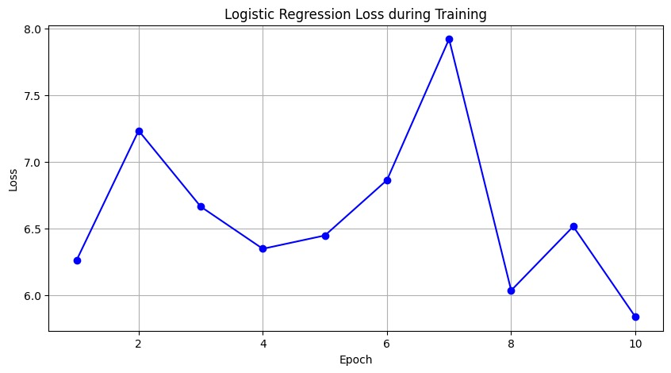
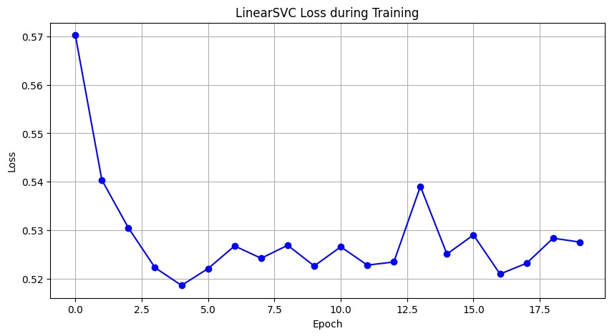
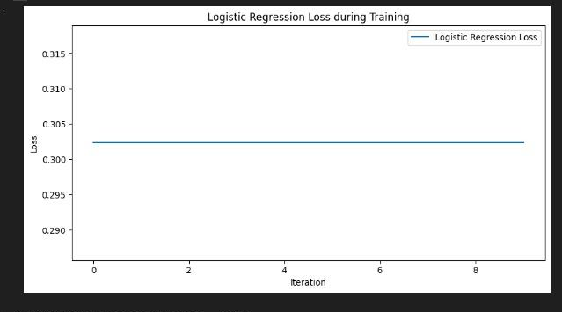
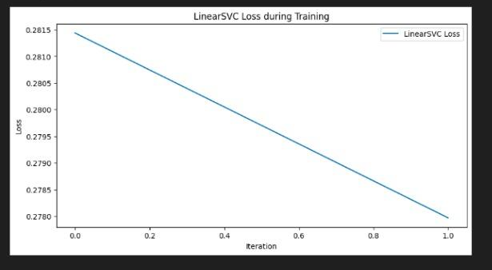
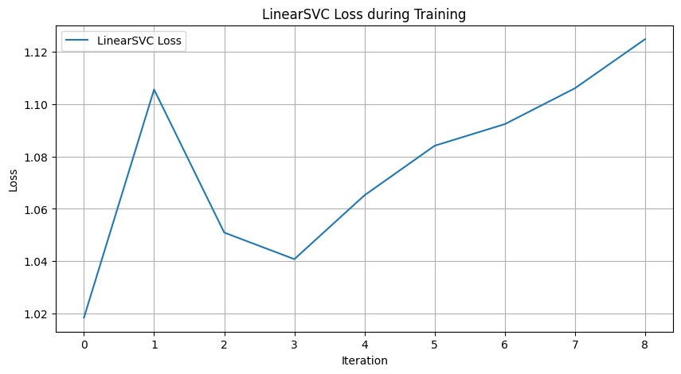
Results & Analysis for SVM and Regression
Loss in Linear Regression is increasing may be due to noisy data and model’s complexity may be inadequate to capture the underlying patterns
Small variations in individual data points affect the model's decision boundary and causes slight changes in loss in Linear SVC, dataset may be noisy.

Slide 15
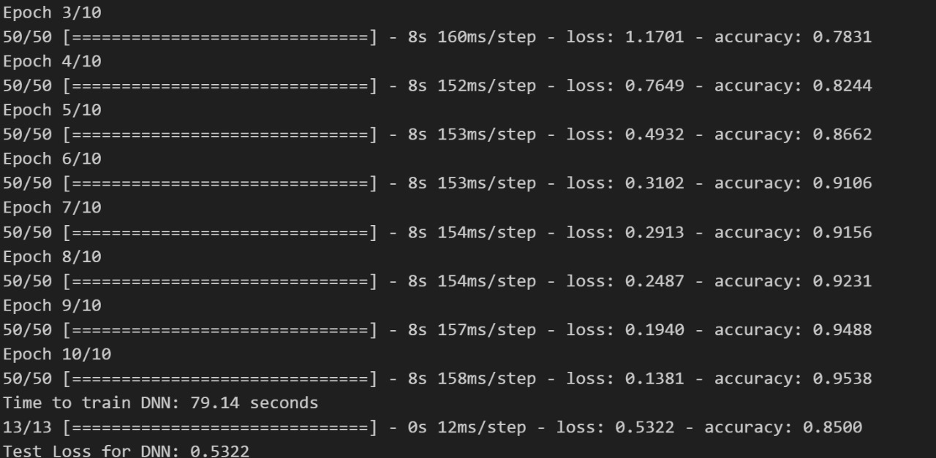
Results & Analysis for CNN of Vehicles and license detection

Slide 16
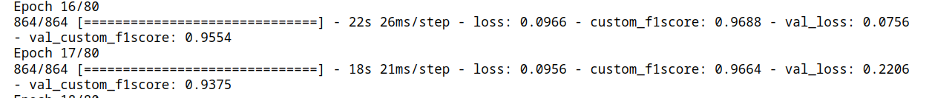
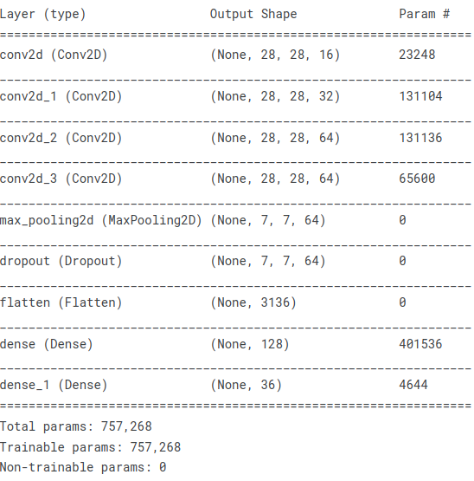
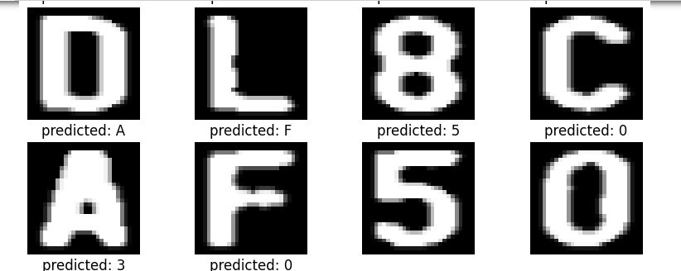
Results & Analysis for CNN of Vehicles and license detection

Slide 17
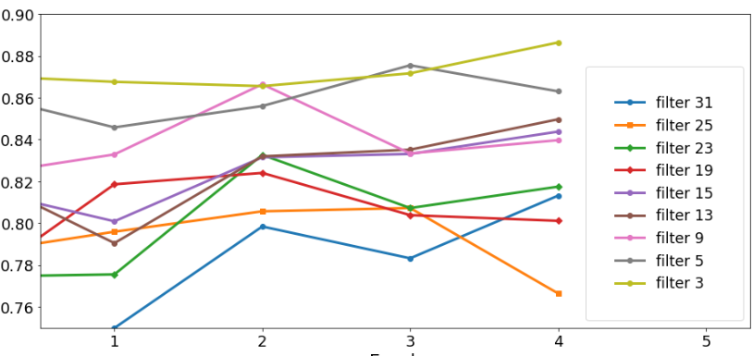
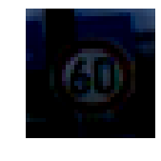
Results & Analysis for CNN of traffic signs
Output on terminal for this:
ClassId: 3
Label: Speed limit

Slide 18
Future Scope
We have models for vehicle detection, identifying license plate numbers for those images. And another model for identifying traffic signs
We can create a pipeline in future where we first received footages of camera, break that into frames and then apply the traffic sign model to know constraints on vehicles for the given scenario
Then, apply vehicle detection and license plate models on culprit frames to identify violations.

Slide 19
Timeline after midem evaluation
16 Oct - 21Oct: Dataset review of license plate and its pre-processing
21 Oct - 31 Oct: CNN on previous datasets
1Nov - 10Nov: CNN for license detection
10 Nov - 20 Nov: CNN for traffic signs
20 Nov - 22 Nov: Model Testing and evaluation

Slide 20
Contribution
Project Planning: Lakshya Sharan, Madhur, Ankush, Anubhav
Data preprocessing: Lakshya Sharan, Madhur
Model Creation and development: Ankush, Anubhav, Lakshya Sharan, Madhur
Performance metrics: Anubhav, Ankush
Documentation: Lakshya Sharan, Madhur, Ankush, Anubhav

